Slide 1
SQL
Joins

Slide 2


Slide 3
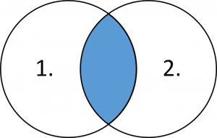

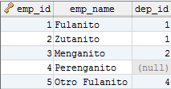


INNER JOIN
SELECT d.*, e.*
FROM department d
INNER JOIN employee e
ON d.dep_id = e.dep_id;
1. Get all relevant Users data and their ShipTos
SELECT u.username
, u.name user
, ur.user_role_id
, ur.description user_role
, st.ship_to_id
, st.name ship_to
, st.address
, st.city_id
FROM user u
INNER JOIN user_role ur
ON u.user_role_id = ur.user_role_id
INNER JOIN ship_to st
ON u.username = st.user;

Slide 4
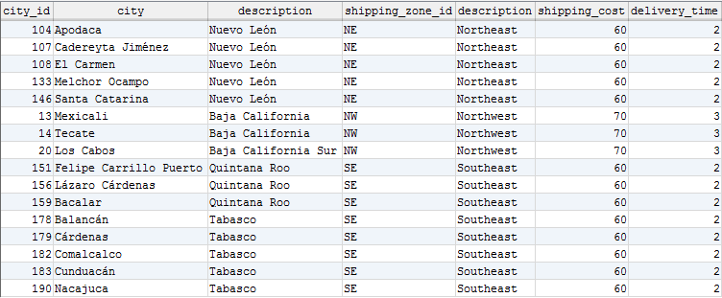
INNER JOIN
2. Get all relevant data from Cities containing “ca” as description and and whose ShippingZone cost is greater than $ 50.
SELECT c.city_id
, c.description city
, s.description
, sz.*
FROM city c
INNER JOIN state s
ON c.state_id = s.state_id
INNER JOIN shipping_zone sz
ON s.shipping_zone_id = sz.shipping_zone_id
WHERE c.description LIKE '%ca%'
AND shipping_cost > 50;

Slide 5
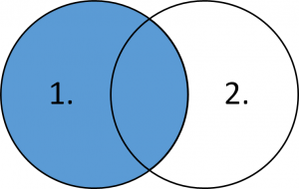
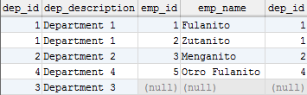
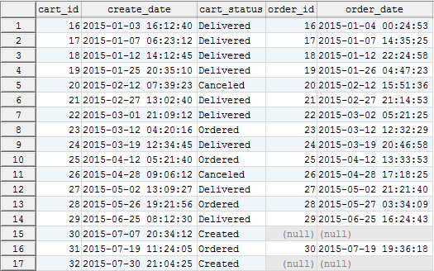
LEFT JOIN
SELECT d.*, e.*
FROM department d
LEFT JOIN employee e
ON d.dep_id = e.dep_id;
3. Create a report from Carts created in 2015, their Status and their order_date if they have. Order the result by cart_id.
SELECT c.cart_id
, c.create_date
, s.description cart_status
, o.order_id
, o.order_date
FROM cart c
INNER JOIN status s
ON c.status_id = s.status_id
LEFT JOIN orders o
ON c.cart_id = o.cart_id
WHERE DATE_FORMAT(c.create_date,'%Y') = '2015'
ORDER BY cart_id;

Slide 6
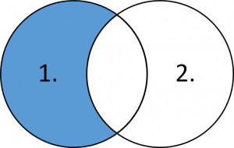

LEFT (excluding) JOIN
SELECT d.*, e.*
FROM department d
LEFT JOIN employee e
ON d.dep_id = e.dep_id
WHERE e.dep_id IS NULL;
4. Create a report from Carts created in 2015 that don't have any Order. Include their Status.
SELECT c.cart_id
, c.lines_amount
, c.shipping_amount
, c.cart_amount
, c.created_date
, s.description cart_status
FROM cart c
INNER JOIN status s
ON c.status_id = s.status_id
LEFT JOIN orders o
ON c.cart_id = o.cart_id
WHERE DATE_FORMAT(c.created_date,'%Y') = '2015'
AND o.order_id IS NULL;

Slide 7
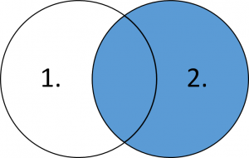
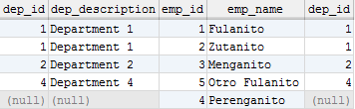
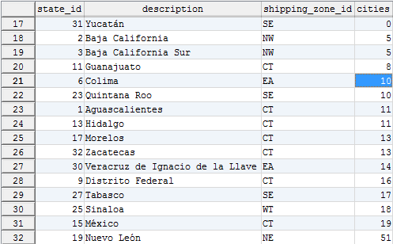
RIGHT JOIN
SELECT d.*, e.*
FROM department d
RIGHT JOIN employee e
ON d.dep_id = e.dep_id;
5. Count Cities by States, including states that don't have any city. Order the results by Number of cities.
SELECT s.*
, COUNT(c.city_id) cities
FROM city c
RIGHT JOIN state s
ON c.state_id = s.state_id
GROUP BY s.state_id
ORDER BY cities, s.state_id;

Slide 8
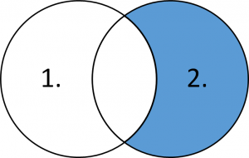

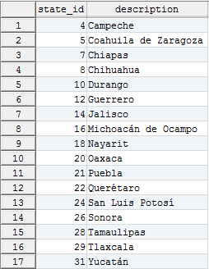
RIGHT (excluding) JOIN
SELECT d.*, e.*
FROM department d
RIGHT JOIN employee e
ON d.dep_id = e.dep_id
WHERE d.dep_id IS NULL;
6. Get a list of States that don't have any Citiy in the report of exercise 5.
SELECT s.state_id
, s.description
FROM city c
RIGHT JOIN state s
ON c.state_id = s.state_id
WHERE c.state_id IS NULL;

Slide 9
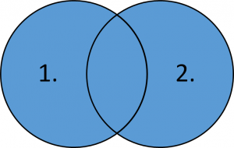
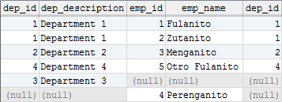
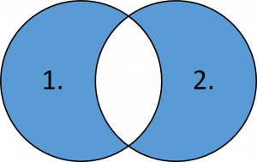

FULL [OUTER] JOIN
SELECT d.*, e.*
FROM department d
FULL JOIN employee e
ON d.dep_id = e.dep_id;
FULL [OUTER] (Excluding) JOIN
SELECT d.*, e.*
FROM department d
FULL JOIN employee e
ON d.dep_id = e.dep_id;
WHERE d.dep_id IS NULL
OR e.dep_id IS NULL;

Slide 11
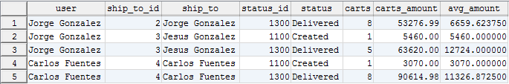
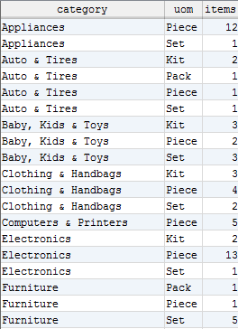
Exercises
1. Get the number of carts by ShipTo and Status, from Carts “CREATED” and “DELIVERED” and which the average of cart_amount on each group is between $ 3,000 and $ 15,000.
Include the relevant description for ShipTo and Status.
2. Get the number of Items by Category and UnitOfMeasure.
Sort the result by Category and then by UOM.

Slide 12
Jorge Luis Gonzalez
jorge.gonzalezm@softtek.com
Instructor

